Slide 1

Mini-Project [DBMS]
(GROUP-5)
TITLE :Pie-in-the-Sky(IPL Match Bidding App)
Submitted by :
Manjunath I Kunte
Munir Sheth
Muzammil Firdous M A
Nandish S Pattanashetti
Nandakumar

Slide 2
Problem Definition
Dataset:
Pie-in-the-Sky is a mobile app that is used for bidding for IPL matches legally. Any
registered user can bid for any of the IPL matches listed in it. New users or bidders need to register themselves into the app by providing their mobile phone number, email id, and password. Admin will maintain the match roster and keep updating other details in the system.
The app shows the match details which include the playing team, the venue of the match, and the current standing of the teams on the points table. It will display the winner at the end of the match and update the team standings in the tournament and bidder points table. System will send updates to the bidders whenever required. It will also generate the bidders' leaderboard.

Slide 3
Problem Statement :
The problem statement is to use the SQL queries to find the various insight from the above-given data. And also write your insights based on the results that you will get from the queries which you will be using.

Slide 4
Business Importance of Problem
The provided information about the "Pie-in-the-Sky" IPL bidding app and its associated database is important for businesses as it offers a platform for legal bidding on IPL matches. This app can provide a competitive and engaging experience for users by allowing them to predict match winners, earn points, and compete on leaderboards. Additionally, the app's database stores valuable data on user preferences, team standings, match results, and more, which can be analyzed to gain insights into user behavior, popular teams, and match outcomes. This information can help businesses tailor marketing strategies, optimize user engagement, and make informed decisions related to team sponsorships, promotions, and user retention strategies.

Slide 5
Q1. Show the percentage of wins of each bidder in the order of highest to lowest percentage.
The question is asking you to display the percentage of wins for each bidder in a certain context from Descending to Ascending order
Gather Data
Calculate Percentages
Sort the Bidders
Display the Results

Slide 6
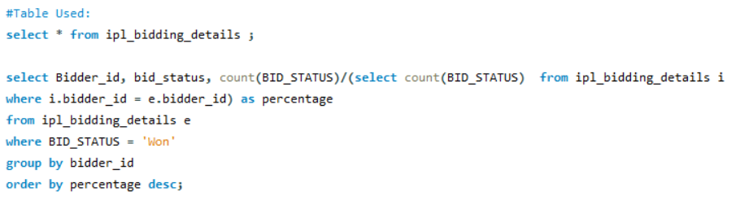
Code:

Slide 7
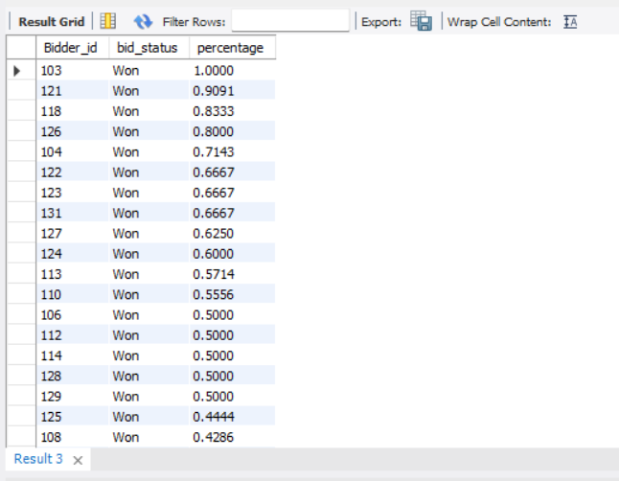
Output:

Slide 8
Q2. Display the number of matches conducted at each stadium with the stadium name and city.
The question is asking you to create a display that shows the number of
matches conducted at each stadium, along with the corresponding stadium name and
city.
1.
2.
3.
4.
Data Source
Data Preparation
Data Analysis
Output

Slide 9
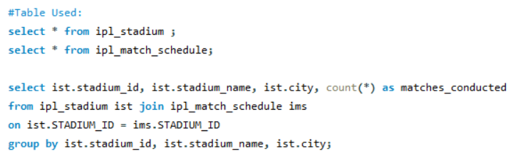
Code:

Slide 10
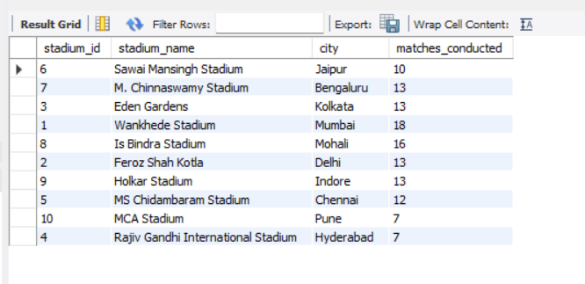
Output:

Slide 11
Q3. In a given stadium, what is the percentage of wins by a team which has won the toss?
The question is asking for the percentage of wins by a specific team in a given
stadium, but with a condition: the team should have won the toss in those matches
they went on to win
1.
2.
3.
4.
Stadium
Team
Toss
Wins

Slide 12
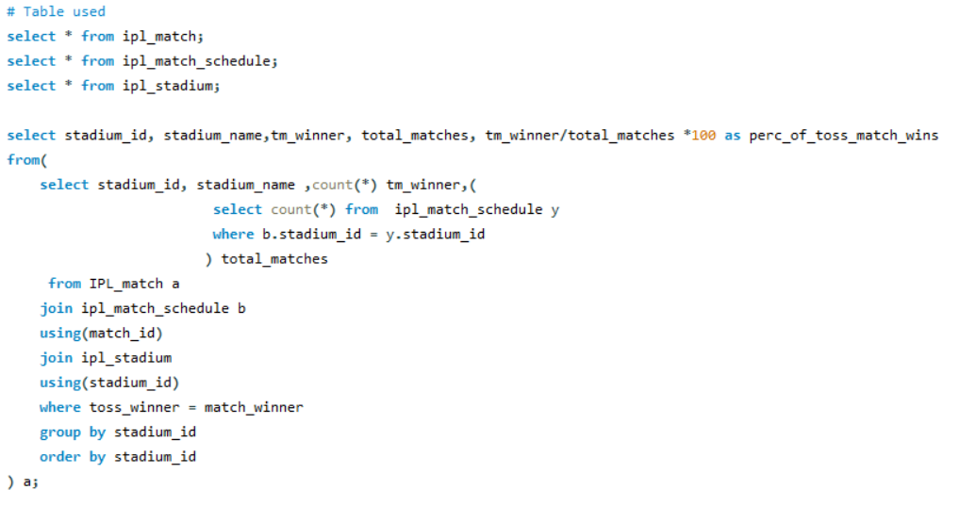
Code:

Slide 13
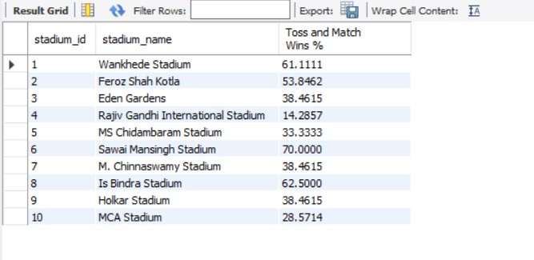
Output:

Slide 14
Q 4. Show the total bids along with the bid team and team name.
We are being asked to present information about the total bids, the team responsible
for each bid, and the names of those teams
1.
2.
3.
4.
Total Bids
Bid Team
Team Name
Output

Slide 15
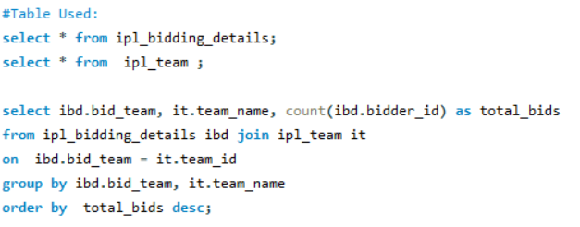
Code:

Slide 16
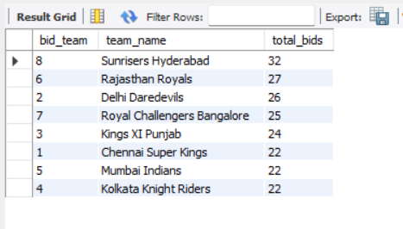
Output:

Slide 17
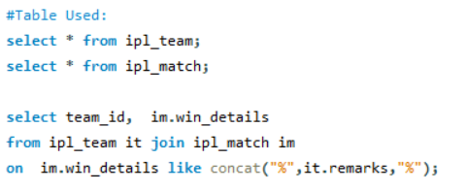
Q 5. Show the team id who won the match as per the win details.
The question is asking you to display or provide information about the team
ID (identification) of the team that won a match based on the "win details.”
Code:

Slide 18
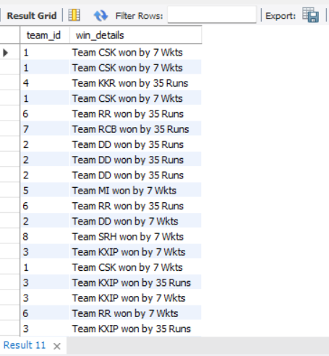
Output:

Slide 19
Q6. Display total matches played, total matches won and total matches lost by the team along with its team name.
This question is asking you to present a summary of a team's performance in a set of matches. The summary should include the following information for the specified team:
Total matches played.
Total matches won.
Total matches lost.
The team's name.

Slide 20
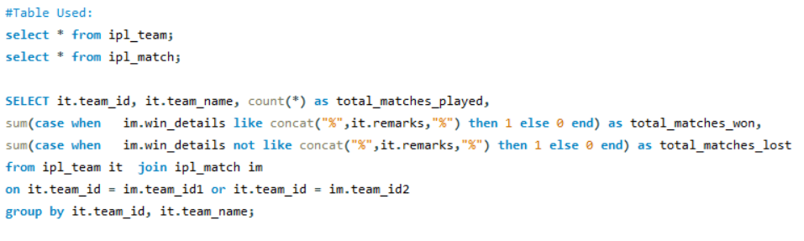
Code:

Slide 21
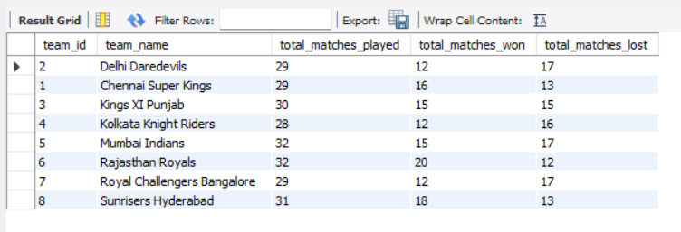
Output:

Slide 22
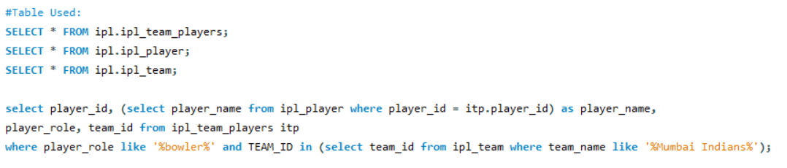
Q 7. Display the bowlers for the Mumbai Indians team.
This question is asking to present a list of bowlers who belong to the "Mumbai
Indians" cricket team.
Code:

Slide 23
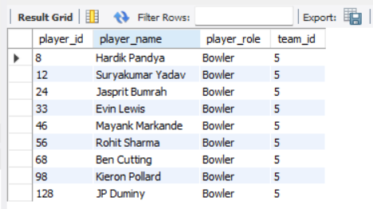
Output:

Slide 24
Q 8. How many all-rounders are there in each team, Display the teams with more than 4 all-rounders in descending order.
The question is asking for information about the number of all-rounders in each team and then requesting the display of teams that have more than 4 all-rounders, listed in descending order based on the number of all-rounders.
Count All-Rounders
Identify Teams
Filter Teams
Descending Order

Slide 25
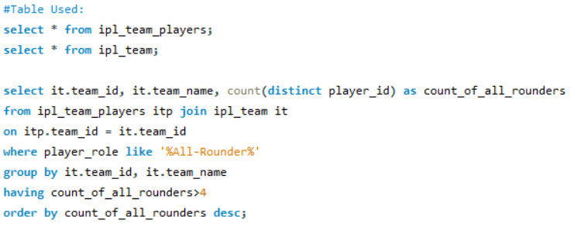
Code:

Slide 26
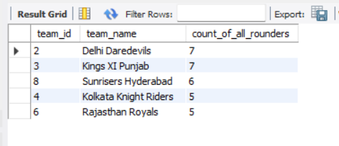
Output:

Slide 27
Q 9.Write a query to get the total bidders points for each bidding status of those bidders who bid on CSK when it won the match in M. Chinnaswamy Stadium bidding year- wise.Note the total bidders’ points in descending order and the year is bidding year.Display columns: bidding status, bid date as year, total bidder’s points
This question is asking you to write a database query that retrieves information about bidders who placed bids on the CSK cricket team when they won matches at the M. Chinnaswamy Stadium. The query should group the data by bidding status and bidding year, and then display the total bidder's points for each combination of bidding status and bidding year. The results should be sorted in descending order based on the total bidder's points. The requested columns in the output are: bidding status, bid date (extracted as year), and total bidder's points.
Filter Bids
Grouping
Calculate Total Points
Ordering
Columns in Output

Slide 28
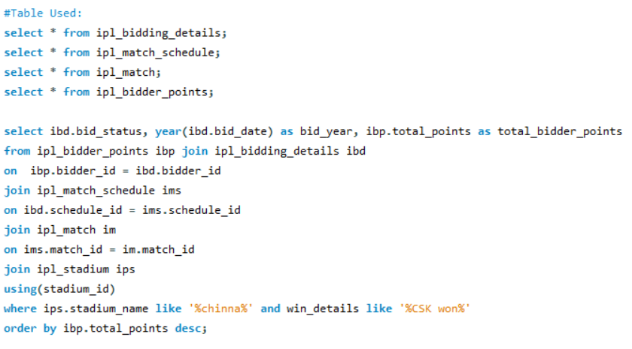
Code:

Slide 29
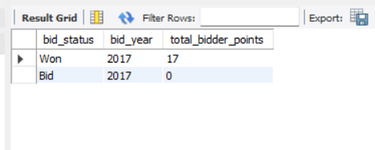
Output:

Slide 30
Q10. Extract the Bowlers and All Rounders those are in the 5 highest number of wickets.
-- Note
use the performance_dtls column from ipl_player to get the total number of wickets
Do not use the limit method because it might not give appropriate results when players have the same number of wickets
Do not use joins in any cases.
Display the following columns team_name, player_name, and player_role.

Slide 31
The task is to extract information about the top bowlers and all-rounders based on the highest number of wickets taken
Understand the Data Sources:I working with a table named ipl_player that contains player details and performance information. The column you need to focus on is performance_dtls
Identify Bowlers and All-Rounders
Sorting Players by Wickets: You are instructed not to use the LIMIT method, which suggests that there might be multiple players with the same number of wickets. Hence, you need to sort the players in descending order based on the number of wickets they have taken.
Displaying Specific Columns: The columns you need to display are team_name, player_name, and player_role.
Avoiding Joins: You are specifically told not to use joins. This indicates that you won't need to combine data from multiple tables. Instead, you'll be working within the ipl_player table itself.
Execute the Query

Slide 32
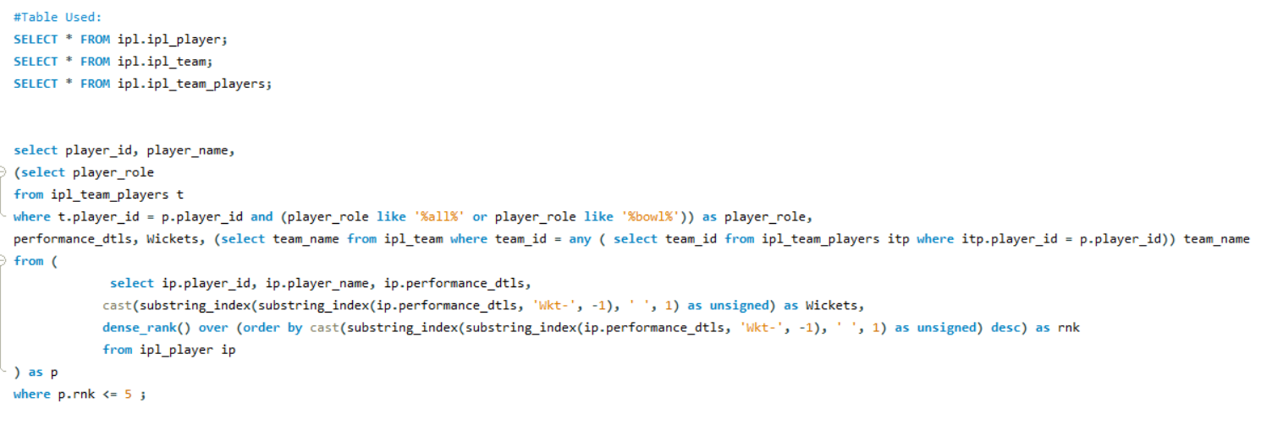
Code:

Slide 33
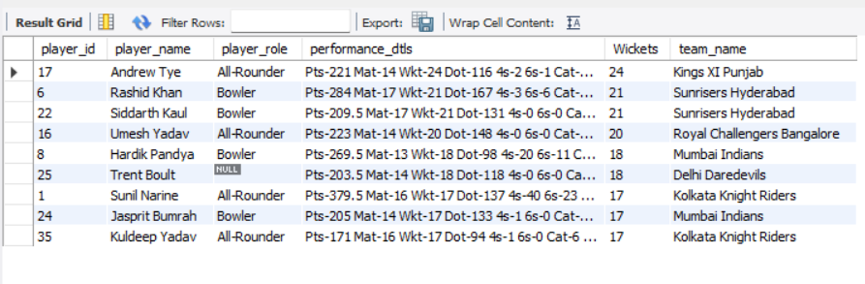
Output:

Slide 34
Q11. show the percentage of toss wins of each bidder and display the results in descending order based on the percentage
The question likely involves analysing the outcomes of coin tosses for these bidders
and calculating the percentage of toss wins for each bidder. The goal is to display the
results in descending order based on the percentage of toss wins.
1.
2.
3.
4.
Gather Data
Calculate Percentages: Percentage of Toss Wins=
Number of Toss Wins
X 100
Arrange in Descending Order
Total Number of Tosses
Display Results

Slide 35
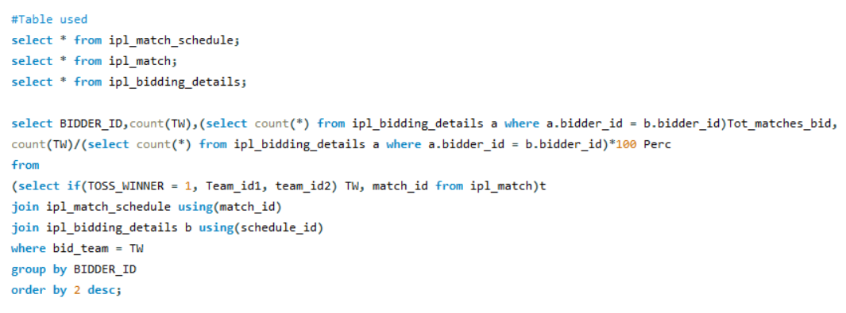
Code:

Slide 36
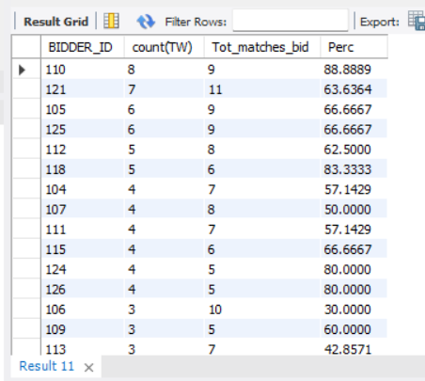
Output:

Slide 37
Q12. find the IPL season which has min duration and max duration.
-- Output columns should be like the below:-- Tournment_ID, Tourment_name, Duration column, Duration
The question involves finding the IPL season with the minimum duration and the one with the maximum duration and also required to display specific output columns: Tournament ID, Tournament name, a column indicating whether it's a minimum or maximum duration, and the duration itself.
Gather Data
Calculate Durations
Find Min and Max
Format Output
Display Results

Slide 38
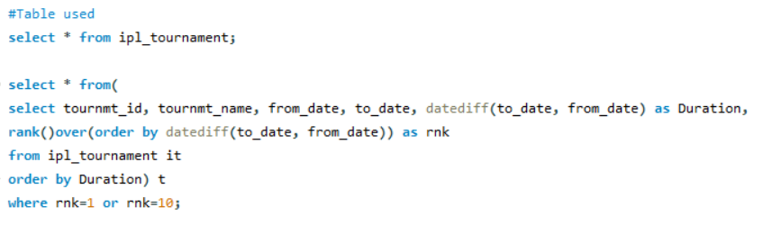
Code:

Slide 39
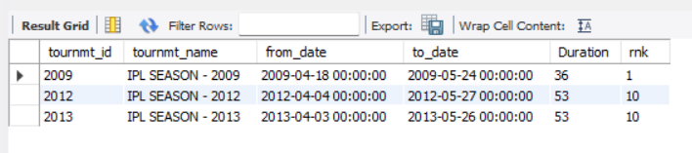
Output:

Slide 40
Q 13. Write a query to display to calculate the total points month-wise for the 2017 bid year. sort the results based on total points in descending order and month-wise in ascending order.
-- Note: Display the following columns:--
1. Bidder ID, 2. Bidder Name, 3. bid date as Year, 4. bid date as Month, 5. Total points-- Only use joins for the above query
Query to calculate the total points month-wise for the 2017 bid year, and then
sorting the results based on total points in descending order and month-wise in
ascending order. The query is expected to display specific columns: Bidder ID, Bidder
Name, bid date as Year, bid date as Month, and Total points. The constraint is to only
use joins for this query.

Slide 41
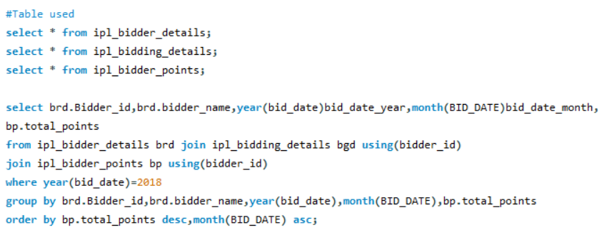
Code:

Slide 42
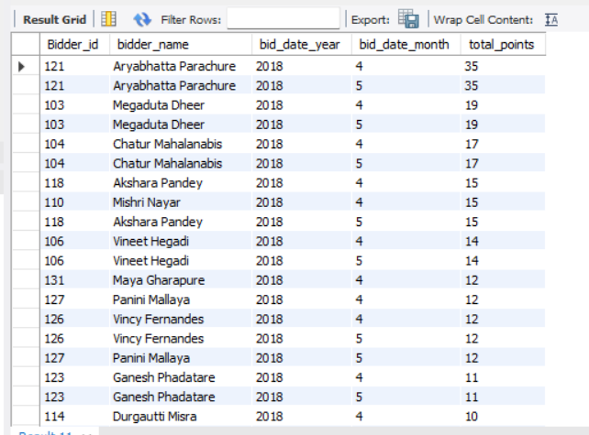
Output:

Slide 43

Q14. Write a query to display to calculate the total points month-wise for the 2017 bid year. sort the results based on total points in descending order and month-wise in ascending order.
-- Note: Display the following columns:--
1.Bidder ID, 2. Bidder Name, 3. bid date as Year, 4. bid date as Month, 5. Total points-- Don't use joins for the above query .
Query to calculate the total points month-wise for the 2017 bid year, and then sorting the results based on total points in descending order and month-wise in ascending order. The query is expected to display specific columns: Bidder ID, Bidder Name, bid date as Year, bid date as Month, and Total points. The constraint is to only use joins for this query.
Note: It is same like previous question but in this instead of Joins we used subqueries

Slide 44
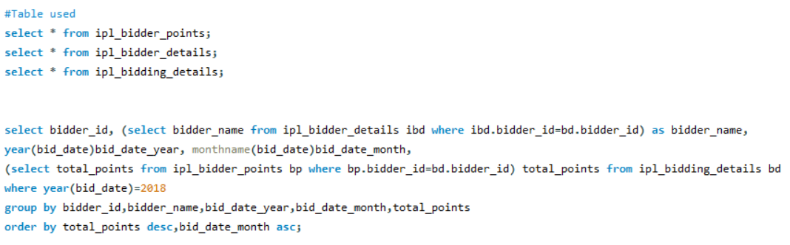
Code:

Slide 45
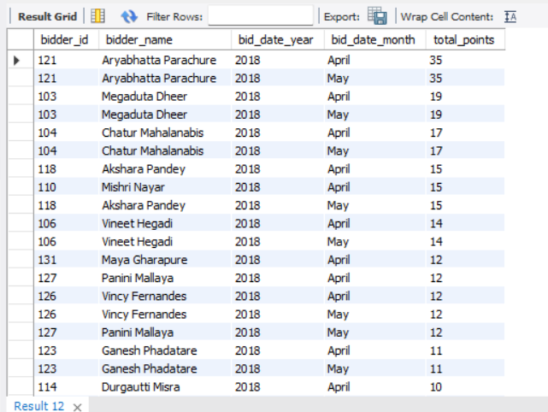
Output:

Slide 46
Q 15. Write a query to get the top 3 and bottom 3 bidders based on the total bidding points for the 2018 bidding year.
-- Output columns should be like:Bidder Id, Ranks (optional), Total points, Highest_3_Bidders --> columns contains name of bidder, Lowest_3_Bidders --
>-- columns contains name of bidder
Query that retrieves information about the top 3 and bottom 3 bidders based on their
total bidding points for the year 2018. The query should provide the bidder's ID, their total
points, and categorise them into "Highest_3_Bidders" and "Lowest_3_Bidders" based on
their ranking in terms of points.

Slide 47
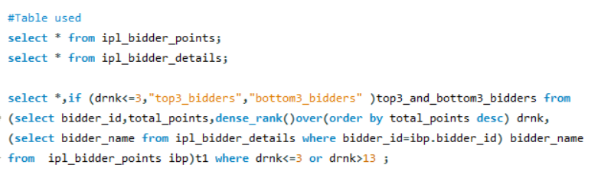
Code:

Slide 48
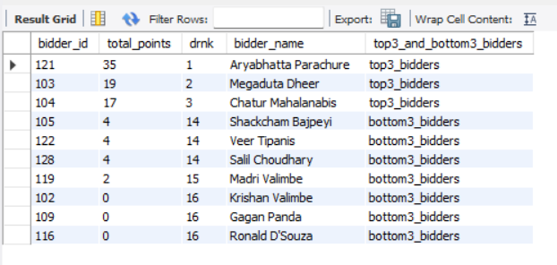
Output:

Slide 49
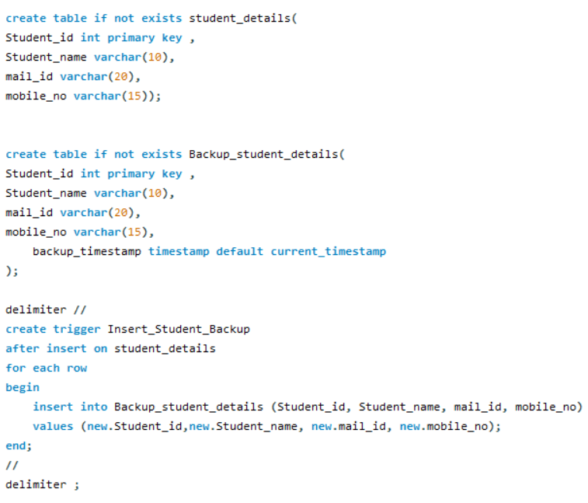
Question16:Create two tables called Student details and Student_details_backup. Create a trigger in such a way that It should insert the details into the Student back table when you inserted the student details into the student table automatically.

Slide 50
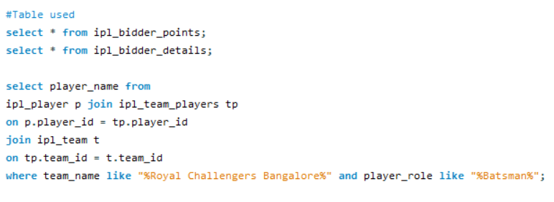
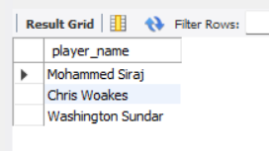
# 17 . List of RCB Batsmen in the season
Inference : The above query gives the all the players who holds the player role as Batsman in team Royal challengers

Slide 51
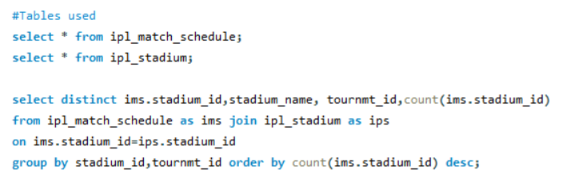
#18 Arrange no of matches played at stadium in 2018 and 2017 in descending order

Slide 52
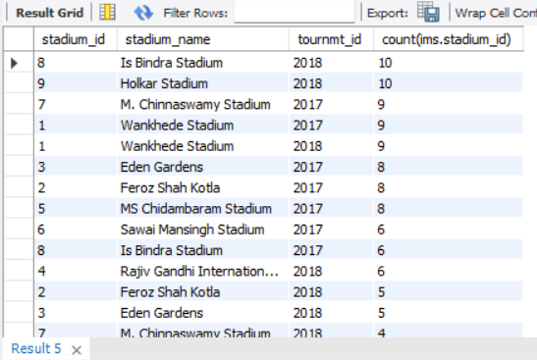

Slide 53
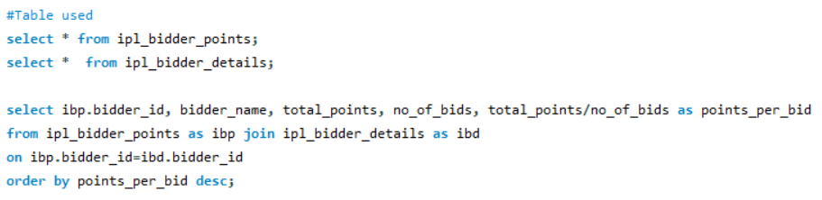
#19 Display best bidders on a per bid basis

Slide 54
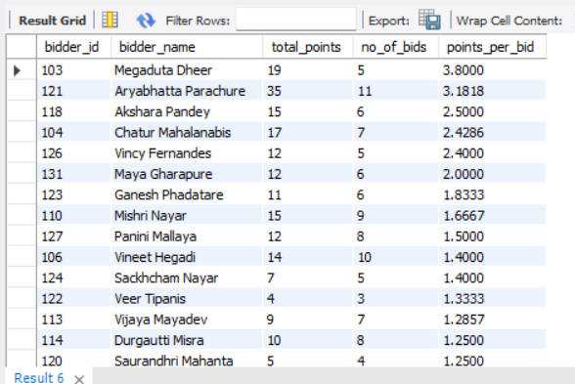

Slide 55
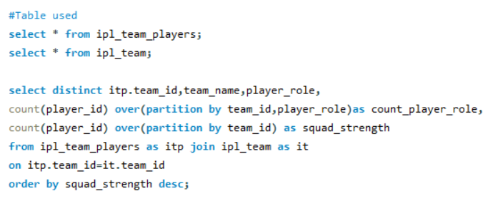
#20 Display ipl team squad strength and strength of player role per team_id in descending order

Slide 56
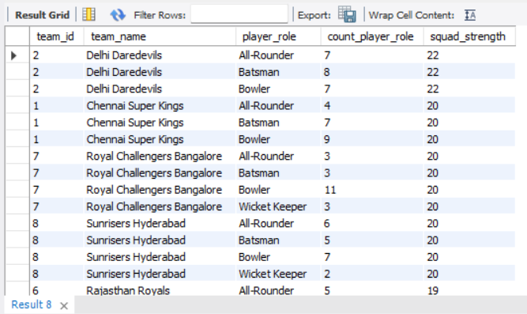

Slide 57
Major Challenge
Database Design Complexity
Performance Optimization
Time Management
SQL projects often involve large datasets and complex queries. Optimizing query performance, indexing, and database configuration can be demanding, especially when dealing with high traffic or resource-intensive operations.

Slide 58
Conclusions
Lessons learned
1. Data Modelling and Design:
•
•
Lesson: Properly designing the database schema is crucial.
Details: The schema should accurately represent the entities (e.g., bidders, matches, bids) and their
relationships. Consider using appropriate data types, primary keys, foreign keys, and normalization
techniques.
2. Efficient Querying:
•
•
Lesson: Optimise queries for performance.
Details: Use indexing on columns frequently used in WHERE clauses or JOIN conditions. Employ query
optimisation techniques to reduce response times and resource consumption.

Slide 59
Data Integrity and Validation:
•
•
Lesson: Enforce data integrity through constraints.
Details: Use constraints like NOT NULL, UNIQUE, FOREIGN KEY, and CHECK to prevent invalid data from
entering the database. This ensures reliable and accurate data.
Backup and Recovery:
•
•
Lesson: Regularly back up the database.
Details: Establish a backup strategy to prevent data loss in case of system failures or disasters. Regularly test
the restoration process to ensure backups are effective.

Slide 60
Skills used
1. Database Design and Modelling:
•
•
Skill: Designing the database schema to represent entities (bidders, matches, bids) and their relationships accurately.
Explanation: Creating tables, defining primary and foreign keys, and establishing relationships between tables.
2. SQL Querying:
•
•
Skill: Writing SQL queries to retrieve, update, and manipulate data.
Explanation: Crafting SELECT statements with various clauses (WHERE, JOIN, GROUP BY, ORDER BY) to retrieve specific
information from the database.
3. Data Manipulation:
•
•
Skill: Inserting, updating, and deleting data in the database.
Explanation: Using INSERT, UPDATE, and DELETE statements to manage the content of the database.
4. Data Validation and Constraints:
•
•
Skill: Applying constraints to enforce data integrity and validation rules.
Explanation: Using NOT NULL, UNIQUE, CHECK, and FOREIGN KEY constraints to prevent invalid data.
5. SQL Joins:
•
•
Skill: Utilizing different types of joins (INNER JOIN, LEFT JOIN, etc.) to retrieve data from multiple related tables.
Explanation: Understanding how to combine data from different tables based on common keys.

Slide 61
Domain understanding developed
1. Understanding IPL Match Bidding:
•
Domain Knowledge: Gain a thorough understanding of how the IPL match bidding process works, including how
teams bid for players, player auctions, match scheduling, team management, and bidding strategies.
•
SQL Application: Design the database schema to accurately model the IPL ecosystem, including entities like teams,
players, matches, bids, and their relationships. This understanding informs table structures, relationships, and data
flow.
2.
Player Data Management:
•
Domain Knowledge: Familiarise yourself with player profiles, performance statistics, player transfers, and
contractual information relevant to IPL players.
•
SQL Application: Develop database tables that store player data, performance metrics, historical records, and
contract details. Design queries to fetch player-specific information for bidding and analysis.
3.
Match Scheduling and Results:
•
Domain Knowledge: Understand how match schedules are created, how match results are recorded, and how team
standings are determined.
•
SQL Application: Build tables to store match schedules, outcomes, and team standings. Create queries to retrieve
match-related data, calculate points, and update team standings after each match.

Slide 62
Thank You !!!....

